Slide 1
Secure data hiding in image using steganography
CAPSTONE PROJECT
Presented By: HARISH S
Student Name : HARISH S
College Name & Department : M Kumarasamy College Of Engineering & Electronics and Communication Engineering

Slide 2
OUTLINE
Problem Statement
Technology used
Wow factor
End users
Result
Conclusion
Git-hub Link

Slide 3
Problem Statement
Data protection stands as the main priority because of increasing dependency on digital platforms for exchanging data. The absence of protection for traditional encryption systems allows hackers to exploit them resulting in a need for hidden communication methods. This proposed algorithm operates as an effective mechanism for steganographic image integration of credit data while preserving visual image quality.

Slide 4
Technology used
Language: Python
Platform: Windows
Libraries Used
Image Processing:
OpenCV – Used for image manipulation and pre processing
Steganography Techniques:
Stegno – To perform LSB (Least Significant Bit) steganography

Slide 5
Wow factors
The dual encryption technique implements AES encryption together with steganography to establish secure protection at two encryption depths.
Steganographic systems with intelligence use data-oriented pixels from image details for hiding embedded data to make detection attempts more challenging.
Due to the hidden nature of embedded data all visual image qualities remain unaltered as observed by all viewers (PSNR and SSIM values).
User-Friendly Application – Designed for both desktop (Tkinter) and web (Flask/Django) platforms for seamless accessibility.

Slide 6
End users
Secure communication serves the needs of organizations which include whistle-blowers, journalists along with those who require secure access to sensitive information.
Cybersecurity specialists maintain protected and confidential data transmission throughout their operations.
Operating organizations which manage vital contracts and intellectual property while needing protected communication lines.

Slide 7
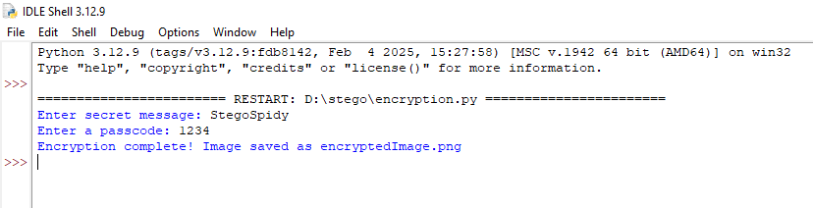
Results

Slide 8
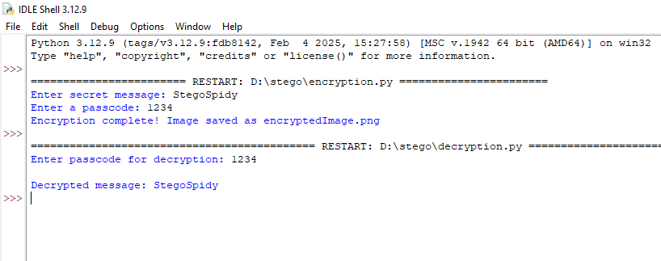

Slide 9


Slide 10
Conclusion
The Image Steganography with Encryption project provides users with a secure transmission method through invisible image-based data embedding. AES encryption provides this solution with the ability to guarantee confidentiality combined with integrity together with resistant steganalysis capability. The solution can be utilized because it works efficiently with multiple platforms while being lightweight and flexible on a large scale..

Slide 11
GitHub Link
https://github.com/Srharish-05/EdunetStego

Slide 12
THANK YOU

